Slide 1

Weekly Report
Tianyu Wang
August 25,2021

Slide 2
Review of Last Meeting
Completed:
Collection of pull request(except checks)
Preprocessing of the data
To do:
Topic modeling on commit message, code comment and pull request

Slide 3

Topic words for commit message
"test","fix","change","commit","remove","add","merge","branch","upgrade","move","added“, "fixed","pull“,"request"
Topic #0:
test fix this the change commit stream run unit also
Topic #1:
use this the also result make write store read data
Topic #2:
support added commit server initial rest client user load example
Topic #3:
merge branch trunk master upgrade new git broken split internal
Topic #4:
add class new version move code package implement get interface
Topic #5:
added fixed remove code removed cleanup bug unused minor issue
Topic #6:
request pull merge close state check exception cluster transaction message
Topic #7:
index formerly work log message make file error sort folder
Topic #8:
query name use value filter string search instead format type
Topic #9:
fix add update test remove support review address bug null

Slide 4
Using Biterm Topic Modelling
Topic #0:
add use class remove fix code support new this test
Topic #1:
use this the memory write also data make new read
Topic #2:
fix add test remove update address use code review support
Topic #3:
this index the use add commit also a new test
Topic #4:
index this store transaction log would use the one file
Topic #5:
the channel result use add this motivation close stream write
Topic #6:
added class new use add test support this code work
Topic #7:
added fixed add issue new fix message list show block
Topic #8:
value name string filter query true range search false see
Topic #9:
merge commit request pull date branch author lee add fix

Slide 5
Topic words for code comment
Topic #0:
when id then given agent page node start time trace
Topic #1:
this method the make sure request run want change bit
Topic #2:
find constant null name exception throw check id set the
Topic #3:
observable source result item function second first apply aggregation give
Topic #4:
thread use long key query server realm wait block start
Topic #5:
row index column sort scroll escalator cell remove element add
Topic #6:
data type give test shape end input code provide want
Topic #7:
array shape dimension along index vector result order new number
Topic #8:
check construct indent creature type state stream send verify level
Topic #9:
file value get line ignore create read data write table

Slide 6
Using Biterm Topic Modelling
Topic #0:
this method set the use one value true read if
Topic #1:
row index scroll escalator column cell element dom width height
Topic #2:
shape array a index dimension along give method stride he
Topic #3:
find constant null id name exception throw the set agent
Topic #4:
observable source function item result second first apply aggregation third
Topic #5:
data file line when a then given provide test input
Topic #6:
thread query make sure realm need wait run task id
Topic #7:
indent request operation notify this server method use connection type
Topic #8:
check long node default value constructor insertion string a simple
Topic #9:
a creature result precision target step put by battlefield alpha

Slide 7
Topic words for pull request
Topic #0:
index use store need instead also cache make like transaction
Topic #1:
work get also use code add need file new one
Topic #2:
variable use color define line like everywhere via else order
Topic #3:
think time task druid thread query add segment use set
Topic #4:
file raw liner status late review previously reviewable revision unresolved
Topic #5:
think use like method make add code need also class
Topic #6:
test coverage do done master file add read tool one
Topic #7:
test add remove realm use change fix exception code class
Topic #8:
shape build protocol run requester server she compression link access
Topic #9:
pull please request fix merge test thanks good issue branch

Slide 8
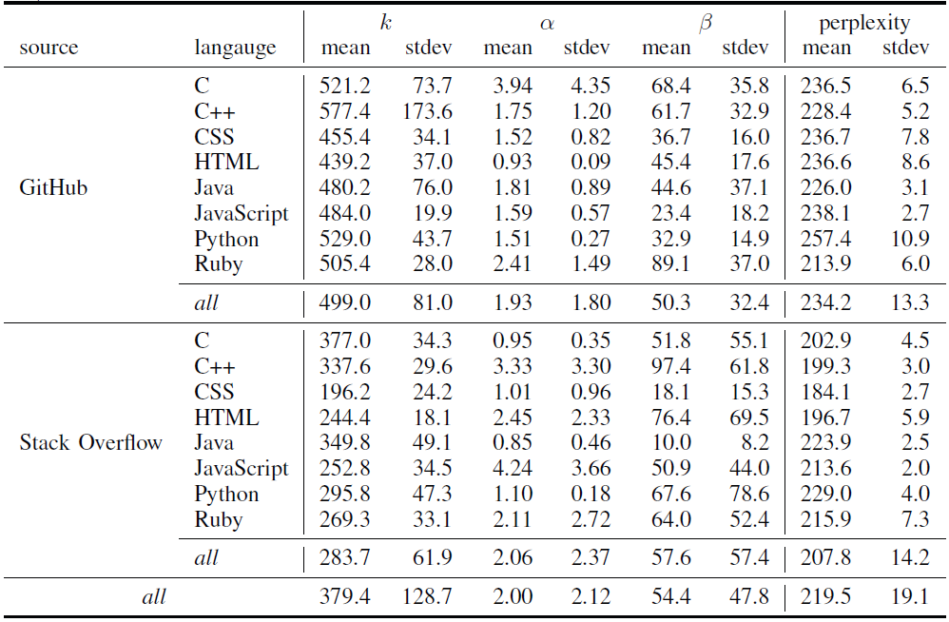
Related work
Predicting Good Configurations for GitHub and Stack Overflow Topic Models

Slide 9
Next Step
1. Summarize the topic.

